Slide 1
A BRIEF INTRODUCTION TO IRON AND STEEL, TESTING, FERROUS CORROSION AND CATHODIC PROTECTION
by
Alan Broomfield M.I.I.M.S.

Slide 2
FERROUS AND FERRIC METALS
IN ORDER TO UNDERSTAND CORROSION IT IS NECESSARY TO KNOW SOMETHING OF THE METALS WITH WHICH SHIPS AND BOATS ARE CONSTRUCTED.
IN THE MARINE WORLD THERE ARE FOUR MAIN FERROUS METALS IN COMMON USE: -
WROUGHT IRON
MILD STEEL (PLAIN CARBON STEEL)
STAINLESS STEEL
CAST IRON
IT IS ALSO NECESSARY TO BE ABLE TO IDENTIFY THEM IN THE FIELD SO THAT THE MARINE SURVEYOR KNOWS WHAT METAL HE IS DEALING WITH.
FERROUS AND FERRIC BOTH COME FROM THE LATIN FERRUM MEANING IRON.

Slide 3
WROUGHT IRON
THIS METAL WILL STILL, EVEN THESE DAYS, BE FOUND IN THE OLDER DUTCH BARGES AND A FEW OF THE OLDER EX-COMMERCIAL NARROW BOATS. IT CAN BE PRODUCED BY A NUMBER OF METHODS BUT THE MOST COMMON OF THESE WAS CALLED THE PUDDLING PROCESS. WROUGHT IRON HAS NOT BEEN PRODUCED COMMERCIALLY, HOWEVER, SINCE THE END OF THE NINETEENTH CENTURY AND IT CEASED TO BE USED AS A BIG SHIP BUILDING MATERIAL ABOUT 1880 BUT WAS STILL IN USE ON THE CONTINENT FOR BARGE BUILDING UP TO ABOUT 1912.

Slide 4
MILD STEEL 1
BY FAR THE MAJORITY OF METAL BOATS THE MODERN MARINE SURVEYOR WILL SEE WILL BE MANUFACTURED FROM MILD STEEL I.E. STEEL WITH ABOUT 0.23% CARBON BY WEIGHT. THIS MATERIAL IS OFTEN, ESPECIALLY IN AMERICA, CALLED PLAIN CARBON STEEL. MILD STEEL WAS PRODUCED BY A NUMBER OF PROCESSES AND CONTINENTAL BARGES WERE OFTEN BUILT FROM MILD STEEL PRODUCED BY THE BESSEMER PROCESS.

Slide 5
MILD STEEL 2
BECAUSE THE BESSEMER METHOD OFTEN PRODUCED STEEL CONTAINING EXCESSIVE QUANTITIES OF NITROGEN, IT WAS FOUND TO BE BRITTLE ESPECIALLY IN COLD WATER AND THE CLASSIFICATION SOCIETIES WOULD NOT ALLOW ITS USE IN SEA GOING SHIP CONSTRUCTION. CLASSED SHIPS HAD TO BE BUILT FROM STEEL MANUFACTURED BY EITHER THE SIEMENS-MARTIN PROCESS OR THE OPEN HEARTH PROCESS.

Slide 6
MILD STEEL 3
BOTH THESE PROCESSES WERE DISCONTINUED IN THE WESTERN WORLD IN ABOUT AD 2000 AND, TODAY SHIPBUILDING STEEL IS PRODUCED BY THE ELECTRIC ARC METHOD. IT IS STILL POSSIBLE TO FIND BARGES BUILT FROM STEEL PRODUCED BY THE BASIC OXYGEN PROCESS BUT THAT METAL SUFFERS FROM THE SAME DEFECT AS BESSEMER STEEL AND IS NOT ALLOWED TO BE USED ON CLASSED SHIPS.

Slide 7
MILD STEEL 4
Mild steel is historically made by a number of processes. The Bessemer process was extensively used on the Continent and in the U.S. But not the UK. It was revamped in the middle of the twentieth century as the Basic Oxygen process. Steel made by either of these processes may not bee used to construct classed ships as the steel contains considerable quantities of nitrogen and is very brittle especially in cold weather.

Slide 8
MILD STEEL 5
Up till the turn of the century classed ships had to be built from steel made by the Siemens Martin or open hearth method. This was replaced in the year 2000 by the Electric Arc method. Boats built post 2000 are likely to be built from Basic Oxygen steel but prior to that date may be built by Siemens Martin or Bessemer steel

Slide 9
STAINLESS STEELS
THESE METALS ARE ALLOYS OF STEEL CONTAINING VARIOUS QUANTITIES OF CHROMIUM AND TITANIUM. THE MARINE SURVEYOR WILL COME ACROSS TWO MAIN VARIETIES CALLED AS 304 AND AS 316. THERE ARE OTHERS.

Slide 10
COMPARISON
WROUGHT IRON HAS LESS THAN 0.05% CARBON BUT CONTAINS A SLAG OF PHOSPHORUS, SULPHUR AND SILICON OF UP TO 2%.
MILD (SHIPBUILDING) STEEL HAS 0.23% CARBON AND ONLY TRACES OF PHOSPHORUS, SULPHUR AND SILICON.
IT IS THE CARBON THAT TURNS WROUGHT IRON INTO STEEL.
CAST IRON HAS ABOVE 2% CARBON.
THE PERCENTAGES GIVEN ARE BY WEIGHT.
WROUGHT IRON HAS A GRANULAR MICROSTRUCTURE BUT THE PRESENCE OF THE SLAG GIVES IT A ‘GRAIN’ SIMILAR TO WOOD.
STEEL HAS A MICROGRANULAR STRUCTURE MADE UP OF CRYSTALS OF FERRITE (PURE IRON), PEARLITE AND CEMENTITE. THERE IS ABOUT 75% FERRITE IN MILD STEEL.

Slide 11
A MYTH
THE MARINE SURVEYOR WILL OFTEN BE TOLD THAT WROUGHT IRON DOES NOT CORRODE. THAT STATEMENT IS RUBBISH. IT DOES CORRODE BUT, BECAUSE OF ITS MICROSTUCTURE AND THE PRESENCE OF UP TO ONE AND A HALF PERCENT PHOSPHORUS, IT CORRODES AT A SLOWER RATE THAN MILD STEEL. IT DOES NOT SUFFER GALVANIC PITTING BUT IT WILL SUFFER ELECTROLYTIC PITTING AND MICROBIOLOGICAL ATTACK OF WHICH MORE LATER.

Slide 12
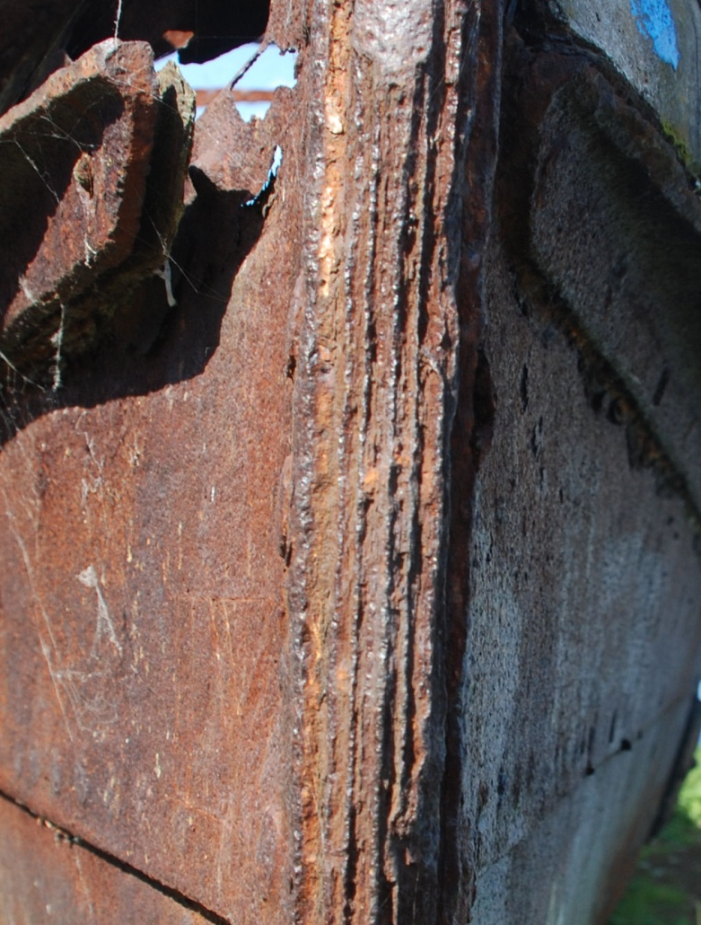
CORROSION ON A WROUGHT IRON STEM SHOWING ‘GRAIN’ EFFECT

Slide 13
IDENTIFICATION
THERE ARE SIX TESTS THAT CAN BE CARRIED OUT TO CORRECTLY IDENTIFY A FERROUS METAL: -
THE VISUAL TEST
THE COLD CHISEL TEST
THE FILE TEST
THE GRINDING OR SPARK TEST
THE HARDNESS TEST
THE ACID TEST
FOR STAINLESS STEEL THERE IS ALSO THE MAGNET TEST.

Slide 14
THE VISUAL TEST
THIS IS NOT STRICTLY A TEST BUT REQUIRES THE USE OF THAT VERY SPECIAL PIECE OF BIOLOGICAL EQUIPMENT CALLED THE BRAIN.
IF THE VESSEL IS AN OLD NARROWBOAT, A DUTCH BARGE OR AN OLD RIVER LEA BARGE IT IS POSSIBLE THAT IF IT IS PRE 1914 THAT IT IS BUILT OF WROUGHT IRON. IF THAT IS THE CASE THERE WILL PROBABLY NOT BE ANY GALVANIC PITTING ALTHOUGH THERE MAY BE SOME ELECTROLYTIC OR MICOBIALLY INDUCED PITTING.
STAINLESS STEELS ARE IDENTIFIED BY THEIR SHINY SILVERY COLOUR.

Slide 15
THE COLD CHISEL TEST 1
BY CUTTING THE SURFACE OF THE METAL WITH A COLD CHISEL STRUCK BY A HAMMER OF SUITABLE WEIGHT, THE MARINE SURVEYOR CAN CHIP OFF SMALL PIECES OF THE METAL.
N.B. WHEN CARRYING OUT THIS TEST, SAFETY GLASSES MUST BE WORN. BEWARE. IT IS ALSO GOOD PRACTICE TO DRIVE THE CHISEL AWAY FROM THE EYES.

Slide 16
THE COLD CHISEL TEST 2
A CHIP TEST WITH A SMALL COLD CHISEL AND HAMMER WILL OFTEN REVEAL STRIKING DIFFERENCES BETWEEN METALS OF SIMILAR SURFACE APPEARANCE. THE TABLE BELOW SUMMARIZES THE CHIPPING CHARACTERISTICS OF SIX TYPES OF FERROUS METAL.

Slide 17
THE COLD CHISEL TEST 3
STRIP CHIPS
UNALLOYED OR MILD STEEL CAST IRON
LONG CONTINUOUS SHAVINGS THE METAL DOES NOT GIVE OFF
ARE FORMED WHEN THE METAL SHAVINGS BUT IS CHISELLED
IS CHISELLED OFF IN THE FORM OF BRITTLE
FRAGMENTS

Slide 18
THE COLD CHISEL TEST 4
METAL | APPEARANCE OF CHIP | SIZE OF CHIP | FACILITY OF CHIPPING
GREY CAST IRON | SMALL PARTIALLY BROKEN | 2 MM | DIFFICULT
MALLEABLE CAST IRON | NOTICEABLY LONGER THAN THOSE FROM GREY IRON GREY CAST IRON | 16 TO 10 MM | VERY TOUGH HARDER TO CHIP THAN GREY CAST IRON
WROUGHT IRON, LOW CARBON STEEL AND CAST STEEL | CAN BE MADE CONTINUOUS; CHISEL LEAVES A SMOOTH GROOVE | ALMOST ANY LENGTH | VERY EASY
HIGH CARBON STEEL | FINE GRAIN FRACTURE NOTICEABLE, ALTHOUGH CHIP MAY BE CONTINUOUS | ALMOST ANY LENGTH | DIFFICULT DUE TO THE HARDNESS OF THE METAL

Slide 19
THE FILE TEST 1
THE SIMPLEST TEST THAT CAN BE APPLIED TO IDENTIFY A METAL IS TO RUN A 12" SECOND CUT FILE OVER ITS SURFACE. THE USE OF A FILE ON THE METALS MOST LIKELY TO BE USED IN SHIP AND BOAT CONSTRUCTION WILL HAVE THE REACTIONS GIVEN IN THE TABLE BELOW.

Slide 20
THE FILE TEST 2
TYPE OF STEEL | RESISTANCE TO FILE | VICKERS HARDNESS NUMBER | BRINELL HARDNESS NUMBER
LOW CARBON OR MILD STEEL | NO RESISTANCE, THE FILE BITES INTO THE METAL | 275 | 130
MEDIUM CARBON HIGH TENSILE STEEL | LITTLE RESISTANCE, THE FILE BITES INTO THE METAL BUT REQUIRES THE APPLICATION OF PRESSURE | 300 | 200
HIGH ALLOY STEEL | MEDIUM RESISTANCE, THE FILE DOES NOT BITE INTO THE METAL AND THE PRESSURE HAS TO BE INCREASED | 340 | 300
HIGH CARBON STEEL | HIGH RESISTANCE, THE METAL CAN BE FILED BUT WITH DIFFICULTY | 365 | 400
TOOL STEEL | HIGH RESISTANCE, THE FILE LEAVES MARKS BUT THE METAL IS ALMOST AS HARD AS THE FILE | 450 | 500
HARDENED TOOL STEEL | HIGH RESISTANCE, THE METAL IS HARDER THAN THE FILE AND THE FILE DOES NOT GRIP | 475 | 600

Slide 21
THE GRINDING OR SPARK TEST 1
MILD STEEL VS. WROUGHT IRON: THE CHIEF DIFFERENCE LIES IN THE COLOUR OF THE SPARK STREAM NEAR THE GRINDING WHEEL. THE CARBON IN THE IACS STEEL WILL YIELD WHITE TO BRIGHT STRAW YELLOW SPARKS, BESSEMER STEEL GIVES OFF DARK YELLOW TO ORANGE SPARKS AND THE EXCESS PHOSPHORUS AND LACK OF CARBON IN WROUGHT IRON WILL MAKE THE SPARKS A DEEP RED COLOUR. THE SHAPE, LENGTH AND COLOUR OF THE SPARKS ARE ALL IMPORTANT. UNALLOYED AND LOW ALLOYED STEELS ARE DIFFICULT TO TELL APART BUT WHEN TESTED TOGETHER THE DIFFERENCE BECOMES OBVIOUS.

Slide 22
THE GRINDING OR SPARK TEST 2
MATERIAL | COMMENTS
WROUGHT IRON | THE SPARKS SEPARATE AT THE ENDS INTO SEVERAL SMALL SPARKS AND ARE OF A DEEP RED COLOUR
BESSEMER MILD STEEL | AS FOR WROUGHT IRON BUT THE SPARKS ARE A DARK YELLOW TO ORANGE COLOUR
SIEMENS MARTIN MILD STEEL | AS FOR WROUGHT IRON BUT THE SPARKS ARE A WHITE TO BRIGHT YELLOW COLOUR
MANGANESE STEEL | THE YELLOW TO RED SPARKS SPLIT UP AND END IN LITTLE STARS
HIGH TENSILE STEEL | AS FOR WROUGHT IRON BUT THE SPARKS ARE A CLEAR WHITE COLOUR
STAINLESS STEEL | BRIGHT YELLOW SPARKS WITH POINTED ENDS
CAST IRON | WEAK RED SPARKS ENDING IN MANY PRONGED YELLOW STARS

Slide 23
THE ACID TEST
OTHER METHODS OF IDENTIFICATION ARE AVAILABLE USING NITRIC AND OTHER ACIDS BUT NEED A SOMEWHAT COMPLEX UNDERSTANDING OF INORGANIC CHEMISTRY. THE ACID TEST IS NOT REALLY PRACTICAL IN THE FIELD BUT THE MARINE SURVEYOR SHOULD KNOW THAT SUCH A TEST IS POSSIBLE.

Slide 24
THE MAGNET TEST
THIS TEST IS USED ON STAINLESS STEEL TO DISTINGUISH BETWEEN THE TYPES. AS 304 STEEL IS FERRITIC IN MICROSTRUCTURE IT WILL WILL HOLD A MAGNET WHEREAS THE AS316 TYPE - THE ONLY TYPE THAT SHOULD BE USED ON A BOAT - IS AUSTENITIC IN MICROSTRUCTURE AND WILL NOT HOLD A MAGNET

Slide 25
OTHER TESTS
STEEL USED FOR THE CONSTRUCTION OF CLASSED SHIPS HAS TO BE RIGOROUSLY TESTED. MANY OF THESE TESTS ARE CARRIED OUT OUT AT THE STEEL WORKS BUT THE MARINE SURVEYOR SHOULD BE FAMILIAR WITH TWO OF THESE: -
THE HARDNESS TEST WHICH IS MEASURED BY THE BRINELL OR VICKERS NUMBER,
THE IMPACT TEST WHICH IS MEASURED BY THE IZOD OR THE CHARPY TEST.

Slide 26
NATURE OF IRON AND STEEL
THE MARINE SURVEYOR SHOULD NOTE THAT STEEL IS ISOTROPIC AND IT DOESN’T MATTER ON WHICH PART OF THE TEST PIECE THE TESTS ARE CARRIED OUT. IRON ON THE OTHER HAND IS ANISOTROPIC AND THE RESULTS OF THE TESTS WILL VARY DEPENDING UPON WHETHER THE TEST IS CARRIED OUT WITH OR ACROSS THE ‘GRAIN’ OF THE METAL.

Slide 27
THE HARDNESS AND IMPACT TESTS
THE MARINE SURVEYOR SHOULD MAKE HIMSELF FAMILIAR WITH THE: -
THE BRINELL TEST.
THE VICKERS TEST,
THE IZOD TEST.
THE CHARPY TEST.
THERE ARE OTHERS.

Slide 28
THE HARDNESS TEST
ONE METHOD OF IDENTIFICATION OF THE PARTICULAR TYPE OF STEEL REQUIRES A KNOWLEDGE OF THE HARDNESS OF THE METAL. THIS CAN BE OBTAINED BY THE USE OF A SUITABLE HARDNESS METER. THESE ARE AVAILABLE BUT ARE VERY EXPENSIVE. THE HARDNESS OF THE STEEL IS A DIRECT FUNCTION OF THE CARBON CONTENT AND, AS MEASURED BY THE BRINELL NUMBER, IS GIVEN BY: -
H_{B} = 190C + 80
WHERE
H_{B} = BRINELL HARDNESS NUMBER
C = CARBON CONTENT % FRACTION
FOR WROUGHT IRON H_{B} IS ABOUT 80 TO 90 AND FOR MILD STEEL ABOUT 120 TO 130

Slide 29
BRINELL HARDNESS NUMBER 1
DR. J. A. BRINELL INVENTED THE BRINELL TEST IN SWEDEN IN AD 1900. THE INDENTER IS PRESSED INTO THE SAMPLE BY AN ACCURATELY CONTROLLED TEST FORCE. THE FORCE IS MAINTAINED FOR A SPECIFIC DWELL TIME, NORMALLY 10 - 15 SECONDS AND THE THICKNESS OF THE SPECIMEN SHOULD NOT BE LESS THAN TEN TIMES THE EXPECTED DEPTH OF THE IMPRESSION. AFTER THE DWELL TIME IS COMPLETE, THE INDENTER IS REMOVED LEAVING A ROUND INDENT IN THE SAMPLE. THE SIZE OF THE INDENT IS THEN DETERMINED OPTICALLY BY MEASURING TWO DIAGONALS OF THE ROUND INDENT USING EITHER A PORTABLE MICROSCOPE OR ONE THAT IS INTEGRATED WITH THE LOAD APPLICATION DEVICE. THE BRINELL HARDNESS NUMBER IS A FUNCTION OF THE TEST FORCE DIVIDED BY THE CURVED SURFACE AREA OF THE INDENT.

Slide 30
BRINELL HARDNESS NUMBER 2
F
D
d

Slide 31
BRINELL NUMBER 3
H_{B} = 2F kg/mm² πD[D – (D² – d²)]
where
D = the diameter of the ball mm
F = the load used kg
H_{B} = the Brinell hardness number -
d = the mean diameter of the indentation mm
π = 3.1416 OR 22/7

Slide 32
VICKERS HARDNESS NUMBER 1
THE VICKERS HARDNESS TEST METHOD IS SIMILAR CONSISTS OF INDENTING THE TEST MATERIAL WITH A DIAMOND INDENTER IN THE FORM OF A RIGHT PYRAMID WITH A SQUARE BASE AND AN ANGLE OF 136 DEGREES BETWEEN OPPOSITE FACES SUBJECTED TO A LOAD OF 1 TO 100 KG. THE FULL LOAD IS NORMALLY APPLIED FOR 10 TO 15 SECONDS. THE TWO DIAGONALS OF THE INDENTATION LEFT IN THE SURFACE OF THE MATERIAL AFTER REMOVAL OF THE LOAD ARE MEASURED USING A MICROSCOPE AND THEIR AVERAGE CALCULATED. THE AREA OF THE SLOPING SURFACE OF THE INDENTATION IS CALCULATED. THE VICKERS HARDNESS IS THE QUOTIENT OBTAINED BY DIVIDING THE KG LOAD BY THE SQUARE MM AREA OF INDENTATION

Slide 33
VICKERS HARDNESS NUMBER 2
F
DIAMOND POINT
INDENT
DIAGONALS ARE d1 AND d2

Slide 34
VICKERS HARDNESS NUMBER 3
H_{V} = 2Fsin136º/2
d²
= 1.854F/d²
where
F = load kg
H_{V} = Vickers hardness number -
d = arithmetic mean of the
two diagonals d₁ and d₂ mm

Slide 35
OTHER HARDNESS NUMBERS
THE BRINELL NUMBER IS THE ONE IN MOST COMMON USE IN SHIPBUILDING. THERE ARE OTHER HARDNESS NUMBERS BUT THEY ARE NEVER USED IN SHIPBUILDING AND IT IS ENOUGH THAT THE MARINE SURVEYOR KNOWS OF THEIR EXISTENCE

Slide 36
IMPACT TESTING 1
DURING THE FIRST PART OF THE 20TH CENTURY, A METALLURGIST NAMED EDWIN GILBERT IZOD (1876–1946) INVENTED AN IMPACT TEST FOR DETERMINING THE SUITABILITY OF VARIOUS METALS TO BE USED AS CUTTING TOOLS. THE TEST INVOLVED A PENDULUM WITH A KNOWN MASS AT THE END OF ITS ARM SWINGING DOWN AND STRIKING THE SPECIMEN AS IT STOOD CLAMPED IN A VERTICAL POSITION. SOME YEARS LATER ANOTHER (FRENCH) METALLURGIST NAMED CHARPY MODIFIED THE TEST SLIGHTLY BY ORIENTING THE SPECIMEN IN A HORIZONTAL FASHION. THESE PENDULUM IMPACT TEST METHODS PROVED TO BE VERY USEFUL PROVIDING RELIABLE, QUALITATIVE IMPACT DATA THROUGHOUT WWII UP UNTIL THE EARLY 70'S.

Slide 37
IMPACT TESTING 2
BOTH TESTS INVOLVE STRIKING A STANDARD SPECIMEN WITH A CONTROLLED WEIGHT PENDULUM TRAVELLING AT A SET SPEED. THE AMOUNT OF ENERGY ABSORBED IN FRACTURING THE TEST PIECE IS MEASURED AND THIS GIVES AN INDICATION OF THE NOTCH TOUGHNESS OF THE TEST MATERIAL. THESE TESTS SHOW THAT METALS CAN BE CLASSIFIED AS BEING EITHER BRITTLE OR DUCTILE. A BRITTLE METAL WILL ABSORB A SMALL AMOUNT OF ENERGY AND A TOUGH DUCTILE METAL A LARGE AMOUNT OF ENERGY. IT SHOULD BE EMPHASISED THAT THESE TESTS ARE QUALITATIVE AND THE RESULTS CAN ONLY BE COMPARED WITH EACH OTHER OR WITH A REQUIREMENT IN A SPECIFICATION – THEY CANNOT BE USED TO CALCULATE THE FRACTURE TOUGHNESS OF A WELD OR PARENT METAL. THE IZOD TEST IS RARELY USED THESE DAYS HAVING BEEN LARGELY REPLACED BY THE CHARPY TEST.

Slide 38
THE IZOD TEST
GAUGE
TEST PIECE HAMMER
CLAMP
THE IZOD MACHINE
GOOD STEEL GIVES AN IZOD NUMBER OF ABOUT 6.3 M.KG (45 FT-LBS).

Slide 39
THE STANDARD TEST PIECE
10 mm 8 mm
55 mm 10 mm
THE V HAS A 2 MM RADIUS AT THE BOTTOM AND IS 45 DEGREES IN ANGLE.

Slide 40
FERROUS/FERRIC CORROSION
IRON HAS TWO FORMS AND CAN FORM TWO LINKS (FERRIC) OR THREE LINKS (FERROUS). THEY ARE KNOWN AS IRON II AND III THE ABILITY LINK WITH ANOTHER ATOM IS CALLED THE CHEMICAL’S VALENCY.
THERE A NUMBER OF FORMS OF FERROUS/FERRIC CORROSION BUT, IN THE MARINE WORLD, THE MOST COMMON ARE: -
GENERAL ELECTRO-CHEMICAL CORROSION OR RUSTING.
GALVANIC PITTING.
ELECTROLYTIC PITTING.
CREVICE AND JACKING CORROSION.

Slide 41
RUST 1
RUST IS THE RESULT OF A GREAT INDUSTRY IN REVERSE GEAR. IRON AND STEEL ARE MADE BY CONVERTING ORE IN THE FORM OF HAEMATITE AND/OR MAGNETITE INTO THE USEABLE METAL. RUSTING IS THE ELECTRO-CHEMICAL CONVERSION OF THE METAL BACK INTO HAEMATITE AND MAGNETITE.

Slide 42
RUST 2
THERE ARE FIVE FORMS OF RUST AND THE MARINE SURVEYOR SHOULD BE ABLE TO IDENTIFY THEM ON SIGHT. THEY ARE: -
WÜSTITE (PRONOUNCED VOOSTITE).
GEOTHITE.
LEPIDOCROCITE.
HAEMATITE.
MAGNETITE.

Slide 43
RUST 3
WÜSTITE IS A VERY FINE BROWN POWDER FOUND ON THE SURFACE OF FERROUS METALS BUT REQUIRES VERY DRY AND ARID CONDITIONS TO FORM AND IS NEVER FOUND NEAR LARGE EXPANSES OF WATER. THE MARINE SURVEYOR SHOULD KNOW OF IT BUT IS HIGHLY UNLIKELY EVER TO SEE IT.

Slide 44
RUST 4
GEOTHITE IS ALSO A FINE BROWN POWDER FOUND ON THE SURFACE OF FERROUS METALS. LEPIDOCROCITE IS SIMILAR AND HAS THE SAME CHEMISTRY BUT LOOKS LIKE SMALL FISH SCALES. BOTH ARE COMMONLY FOUND ON STEEL LEFT IN THE OPEN AIR FOR ANY LENGTH OF TIME. THEY ARE EASILY BRUSHED OFF BY A WIRE BRUSH AND ARE NOT SERIOUS. THE LOSS THEY CAUSE TO THE THICKNESS OF THE STEEL IS NEGLIGABLE.

Slide 45
RUST 5
HAEMATITE IS WHAT PEOPLE USUALLY CONSIDER TO BE RUST AND IN AN ADVANCE STAGE FORMS THICK SCALES WHICH NEED TO BE CHIPPED OFF WITH A HAMMER OR SIMILAR TOOL. IT REDUCES THE THICKNESS OF THE STEEL SAVAGELY. 1 MM OF STEEL PRODUCES APPROXIMATELY 8 TO 10 MM OF HAEMATITE RUST SCALE. THE NAME COMES FROM THE GREEK FOR BLOOD AS THE SCALES ARE BLOOD RED IN COLOUR PARTICULARLY IF WET. THE INCREASE IN THICKNESS IS DUE TO ATOMIC FORCES DRIVING THE INDIVIDUAL MOLECULES APART.

Slide 46
RUST 6
MAGNETITE IS MAGNETIC. IN ITS NATURAL FORM IT IS CALLED LODESTONE AND SUITABLE LUMPS OF LODESTONE WERE USED BY THE VIKINGS AND ANCIENT CHINESE AS A PRIMITIVE COMPASS. IT IS BLACK AND LUSTROUS AND ITS EFFECTS ON THE STEEL ARE DISASTROUS. IF FOUND, IT IS A CROP AND RENEW JOB.

Slide 47
RUST CHEMISTRY 1
RUST IS FORMED ON IRON BY THE PRESENCE OF WATER AND OXYGEN. THE MARINE SURVEYOR SHOULD BE FAMILIAR WITH THE RUST TRIANGLE: -
WATER
IRON OXYGEN
RUST IS PERMEABLE TO AIR AND WATER, THEREFORE THE INTERIOR METALLIC IRON BENEATH A RUST LAYER CONTINUES TO CORRODE.

Slide 48
RUST CHEMISTRY 2
WÜSTITE IS ANHYDROUS FERROUS OXIDE FE_{0.935}0
GEOTHITE AND LEPIDOCROCITE ARE HYDRATED FERROUS OXIDE, FEO(OH)
HAEMATITE IS HYDRATED FERRIC OXIDE, FE₂0₃
MAGNETITE IS FERROSOFERRIC OXIDE OR MIXED FERROUS AND FERRIC OXIDES, FE₃O₄

Slide 49
DETERIORATION OF MILD STEEL 1
THE PAINTED SURFACE SHOWS NO SIGN OF CRACKING OR PAINT BUBBLES. THERE IS NO PITTING, NO ETCHING AND THE SURFACE SHOWS NO RUST STAIN OR TRACE OF RUST AND THE SURFACE COATING IS NOT COMPROMISED. NO CORRECTIVE MEASURES ARE REQUIRED BUT THE SURFACE MUST BE MAINTAINED IN A CLEAN CONDITION, FREE OF SALT AND OTHER CONTAMINATING AGENTS SUCH AS DIRT, GREASE, SOLVENT AND CONTAMINATED WATER ETC.

Slide 50
DETERIORATION OF MILD STEEL 2
THE PAINTED SURFACE IS BUBBLY OR THE PAINT BUBBLES HAVE BROKEN TO REVEAL RUSTY RED, BLACK OR WHITE CORROSION DEPOSITS ON THE METAL SURFACE WHICH MAY BE ACCOMPANIED BY MINOR ETCHING OR PITTING OF THE METAL. NO SCALE WILL BE PRESENT BUT THE METAL MAY HAVE LOOSE, POWDERY OR SMALL GRANULAR DEPOSITS ON THE SURFACE. THE BASE METAL IS SOUND WITH NO DIRECT VISUAL EVIDENCE OF PITTING BUT THE SURFACE COATING HAS BEEN COMPROMISED. THE CONDITION DOES NOT REQUIRE IMMEDIATE CORRECTIVE ACTION BUT THE SURFACE SHOULD BE CLEANED AND A CORROSION CONTROL COATING SHOULD BE APPLIED TO PREVENT THE CONDITION DETERIORATING.

Slide 51
DETERIORATION OF MILD STEEL 3
A POWERED GRANULAR (GEOTHITE) OR SCALED (LEPIDOCROCITE) CONDITION EXITS ON THE SURFACE METAL AND RUSTY RED, BLACK OR WHITE CORROSION DEPOSITS ARE PRESENT. THE METAL SURFACE MAY BE ETCHED OR PITTED BUT BENEATH THE CORRODED AREA THE METAL IS STILL RELATIVELY SOUND. THE SURFACE SHOULD BE CLEANED BY ANY APPLICABLE PROCESS AND A CORROSION CONTROL COATING APPLIED AND THE PAINT TOUCHED UP AS NECESSARY. FOR A STRUCTURE WHERE A CRITICAL THICKNESS IS ESSENTIAL, A SUITABLE CORROSION CONTROL COATING IS A NECESSITY.

Slide 52
DETERIORATION OF MILD STEEL 4
THE SURFACE CONDITIONS AND CORROSION DEPOSITS PRESENT ARE SIMILAR TO STAGE 3 EXCEPT THAT THE RUST FLAKES (LIGHT HAEMATITE) HAVE STARTED TO DEVELOP AND INCREASE IN THICKNESS AND THE UNDERLYING METAL IN THE CORRODED AREA IS UNSOUND AND SMALL PIN HOLES MAY BE PRESENT. RUST SCALES ACCOMPANIED SINGULARLY OR IN COMBINATION WITH ETCHING, PITTING OR MORE EXTENSIVE SURFACE DAMAGE IS CLEARLY VISIBLE. CORRECTIVE ACTION IS REQUIRED IMMEDIATELY. CLEAN THE SURFACE BY ANY APPLICABLE PROCESS INCLUDING CHIPPING OFF THE RUST SCALES AND REPAIR THE DAMAGED SURFACE. A SUITABLE CORROSION CONTROL COATING TO COVER THE ENTIRE SURFACE SHOULD BE APPLIED AND THE AREA RECOATED. AT THIS STAGE THE FUNCTION OR FITNESS OF THE AREA WILL BE AFFECTED AND IMMEDIATE CORRECTIVE ACTION IS REQUIRED. ALL RUST MUST BE REMOVED, THE SURFACE CLEANED PROPERLY AND WHERE CRITICAL THICKNESS IS ESSENTIAL, THE APPLICATION OF A SUITABLE CORROSION CONTROL COATING IS A NECESSITY. DOUBLING IS NOT RECOMMENDED.

Slide 53
DETERIORATION OF MILD STEEL 5
THICK HAEMATITE SCALES COVER THE AREA AND CORROSION HAS ADVANCED TO THE POINT WHERE THE METAL HAS BEEN PENETRATED THROUGHOUT AND NO METAL REMAINS AT THE POINTS OF THE MOST SEVERE CORROSION. THERE ARE HOLES IN THE SURFACE AREA OR METAL MAY BE COMPLETELY MISSING ALONG THE EDGES OF THE PLATE OR SECTION. AREAS OF BLACK, SHINY MAGNETITE MAY BE VISIBLE UNDER THE SCALES. CORRECTIVE ACTION IS REQUIRED IMMEDIATELY. THE WHOLE SURFACE SHOULD BE CLEANED OF RUST BY ANY APPLICABLE PROCESS AND THE DAMAGED STEEL REPAIRED BY CROPPING AND RENEWAL. DOUBLING IS DEFINITELY NOT RECOMMENDED. A SUITABLE CORROSION CONTROL COATING SHOULD BE APPLIED TO COVER THE ENTIRE SURFACE WHICH SHOULD THEN RECOATED WITH PAINT. AT THIS STAGE THE FUNCTION OR FITNESS OF THE STEEL WILL BE COMPROMISED AND/OR GREATLY AFFECTED AND, WHERE CRITICAL THICKNESS IS ESSENTIAL , THE APPLICATION OF A SUITABLE CORROSION CONTROL COATING IS AN ABSOLUTE NECESSITY.

Slide 54
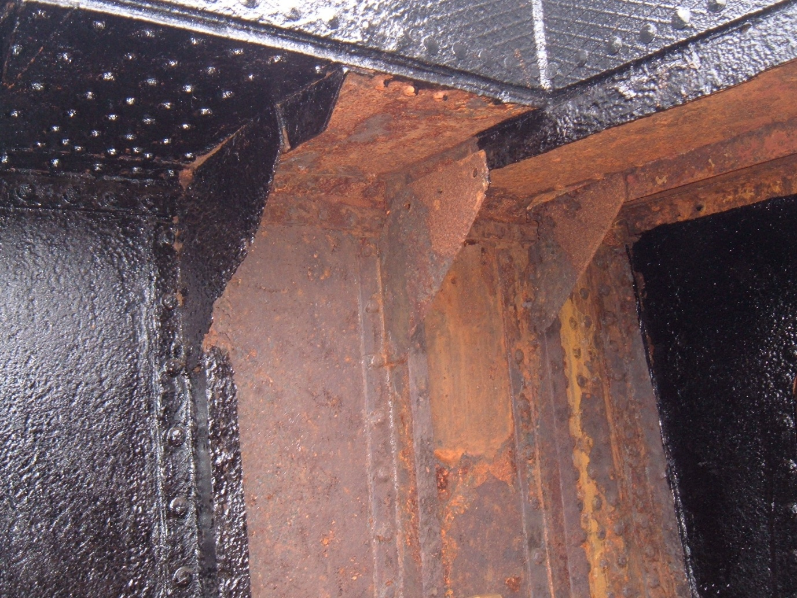
HAEMATITE RUST INSIDE A BARGE

Slide 55
PITTING 1
USUALLY THE MOST COMMON FORM OF CORROSION FOUND ON THE SHELL PLATING OF A METAL BOAT IS PITTING WHICH IS OFTEN AND INCORRECTLY DESCRIBED AS ELECTROLYSIS. TRUE ELECTROLYSIS IS A PROCESS AND WHICH IN FACT, THESE DAYS, IS QUITE RARE AND BY FAR THE MAJORITY OF PITTING THE MARINE SURVEYOR WILL SEE IS DUE TO SIMPLE GALVANIC ACTION AND HE MUST UNDERSTAND BOTH THAT FACT AND THE DIFFERENCE BETWEEN THE TWO PROCESSES.

Slide 56
PITTING 2 – GALVANISM 1
IF A PIECE OF IRON AND A PIECE OF COPPER ARE CONNECTED TOGETHER BY A WIRE AND THEN THEIR ENDS PLACED IN SEAWATER (CALLED THE ELECTROLYTE) THE IRON WILL CORRODE. THE PROCESS IS CALLED GALVANISM. THE IRON IS CALLED THE ANODE AND THE COPPER IS CALLED THE CATHODE.

Slide 57
PITTING 3 – GALVANISM 2
STEEL HAS A GRANULAR MICROSTRUCTURE MADE OF GRAINS CALLED FERRITE, PEARLITE AND CEMENTITE ALL OF WHICH HAVE DIFFERENT ELECTRIC POTENTIALS AND WHEN A SHEET OF STEEL IS PLACED IN THE WATER THE CEMENTITE AND PEARLITE ARE CATHODIC AND THE FERRITE IS ANODIC WITH THE RESULT THAT – DUE TO THE PROCESS OF GALVANISM – THE FERRITE CORRODES. THE RESULTANT PITTING IS NOT DUE TO THE PROCESS OF ELECTROLYSIS AND SHOULD NOT BE SO CALLED.

Slide 58
PITTING 4
WHAT THEN IS THE DIFFERENCE BETWEEN THE PROCESSES OF GALVANISM AND ELECTROLYSIS?
TRUE ELECTROLYSIS IS A PROCESS THAT REQUIRES AN EXTERNAL ELECTROMOTIVE FORCE IN THE FORM OF A SUPPLY OF ELECTRICITY IN THE PIECE OF WIRE CONNECTING THE IRON TO THE COPPER. SEE SLIDE 54.
GALVANISM DOES NOT HAVE THAT EXTERNAL ELECTRICITY SUPPLY.
THE END RESULT, HOWEVER, THE PITTING IS THE SAME.
PITTING IS MEASURED BY A DEPTH GAUGE.
IT IS WRONG TO CALL PITTING EITHER GALVANISM OR ELECTROLYSIS. THEY ARE PROCESSES WHICH RESULT IN PITTING.

Slide 59
PITTING 5
POWER SOURCE
ANODIC CATHODIC
CRYSTAL CRYSTAL SKIN FITTING
PITTING SHELL
PITTING
CURRENT FLOW
CURRENT FLOW
PRINCIPLE OF GALVANISM PRINCIPLE OF ELECTROLYSIS

Slide 60
PITTING 6
WITH GALVANISM, THE PITTING TENDS TO BE SPREAD ALONG THE WIND AND WATER STRAKE OVER THE FULL LENGTH OF THE VESSEL BUT WITH TRUE ELECTROLYSIS THE PITTING TENDS TO BE CONCENTRATED IN ONE AREA AND IS USUALLY DUE TO AN EARTH LEAK ON THE VESSEL’S ELECTRICAL SYSTEM OR TO A STRAY CURRENT LEAK ON NEARBY VESSELS OR MOORING PONTOONS.

Slide 61
STRAY CURRENTS AND ELECTROLYSIS 1
IN THE EARLY DAYS WHEN D.C. ELECTRICITY WAS FIRST USED ON SHIPBOARD THE HULL WAS OFTEN USED AS AN EARTH RETURN. THIS RESULTED IN PITTING OF THE HULL WHICH WAS DUE TO ELECTROLYSIS. AS IT IS NO LONGER ALLOWED TO USE THE HULL SO, THAT SOURCE OF ELECTROLYSIS CEASED AND ANY PITTING FOUND TODAY IS USUALLY DUE TO GALVANISM AND SHOULD NOT BE CALLED ELECTROLYSIS. HOWEVER, THERE ARE STRAY CURRENTS FROM ONE OF THREE POSSIBLE SOURCES WHICH DO CAUSE ELCTROLYTIC PITTING. THOSE SOURCES ARE: -

Slide 62
STRAY CURRENTS AND ELECTROLYSIS 2
BAD CONNECTIONS TO EARTH ON BOARD THE SUBJECT BOAT.
BAD CONNECTIONS TO EARTH ON A NEARBY BOAT TO WHICH THE SUBJECT BOAT IS ELECTRICALLY CONNECTED.
INDUCED CURRENTS OR BAD EARTH CONNECTIONS IN THE NEUTRAL LINE IN A THREE WIRE (A.C.) ON THE PONTOON TO WHICH THE SUBJECT BOAT IS ELECTRICALLY CONNECTED.
IT IS INCUMBENT UPON THE BOAT OWNER TO TAKE CARE OF HIS OWN BOAT AND TO BE CAREFUL OF WHERE AND HOW HE MOORS UP.

Slide 63
STRAY CURRENTS AND ELECTROLYSIS 2
STRAY ELECTRIC CURRENTS TAKE
THE SHORTEST PATH TO EARTH.

Slide 64
CREVICE AND JACKING CORROSION
THIS FORM OF CORROSION IS GALVANIC IN ORIGIN AND CAN HAVE SEVERE EFFECTS ON THE BOAT’S STRUCTURE. SEE SLIDE 62.

Slide 65
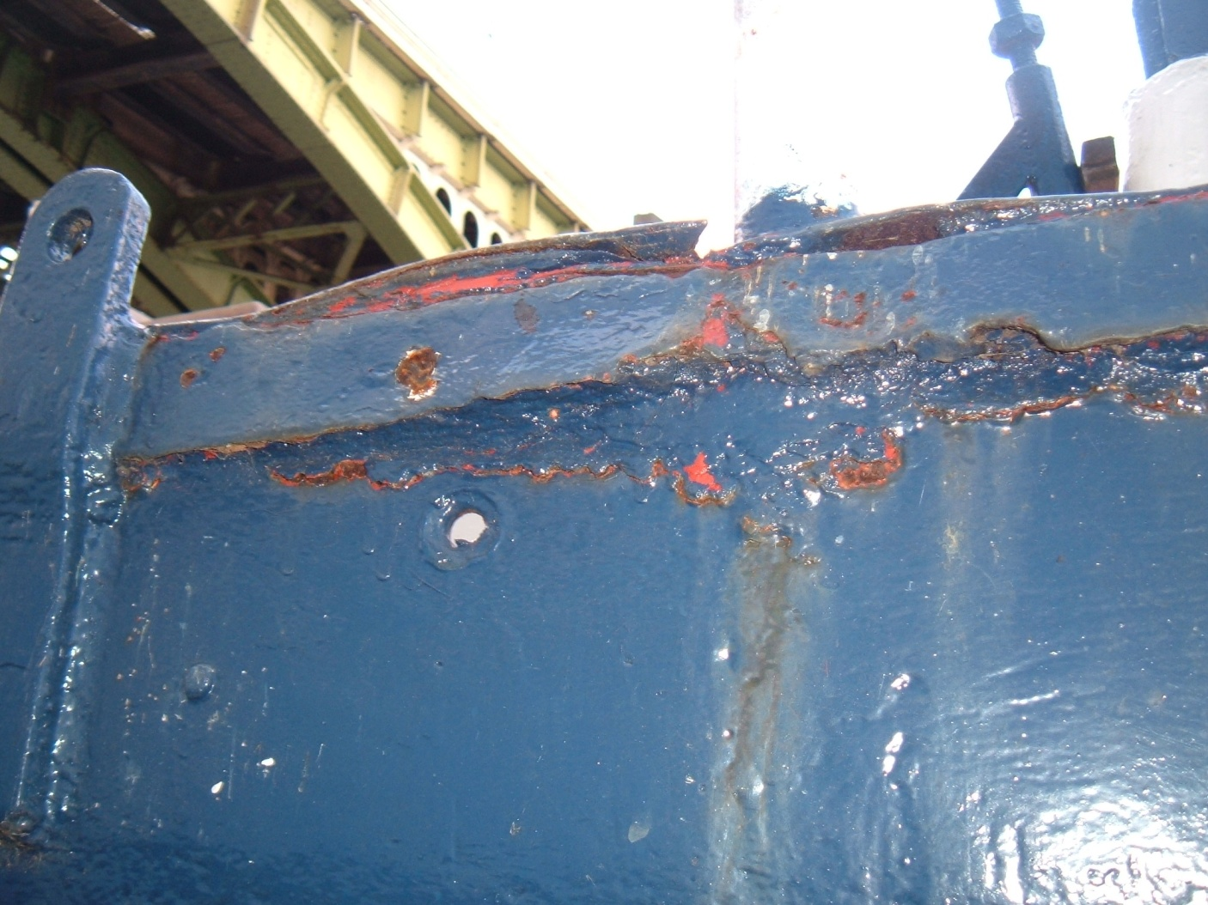
CREVICE AND JACKING CORROSION

Slide 66
CORROSION AREAS 1
GENERAL CORROSION IN THE FORM OF HAEMATITE AND MAGNETITE ARE MOST LIKELY TO BE FOUND IN THE FOLLOWING PLACES: -
ON THE BOTTOM PLATES OF DUTCH BARGES, NARROWBOATS AND OTHER BARGES
THE HEELS OF BULKHEADS ESPECIALLY IN WAY OF HOLD CEILINGS
THE INSIDE OF WATER BALLAST AND FRESH WATER TANKS AND THE SHELL PLATING IN WAY
FORE PEAKS, AFTER PEAKS AND THE INSIDE OF COUNTER STERNS AND THE SHELL PLATING IN WAY.
INACCESSIBLE PLACES IN WAY OF THE HEADS
FLOORS UNDER HOLD OR ACCOMMODATION CEILINGS.
THIS DOES NOT MEAN THAT IT WILL NOT BE FOUND ELSEWHERE.

Slide 67
CORROSION AREAS 2
PITTING DUE TO GALVANISM IS USUALLY FOUND ALONG BOTH SIDES OF THE VESSEL IN WAY OF THE WIND AND WATERLINE STRAKE
CREVICE AND JACKING CORROSION IS USUALLY FOUND UNDER OR BEHIND HALF ROUND RUBBING BARS ALONG THE SHELL OR ON THE TOP OF BULWARKS AND, IN DUTCH BARGES, BETWEEN THE FACE OF THE FRAMES AND THE INSIDE OF THE SHELL PLATING AT PLACES WHERE THE FRAMES HAVE BEEN SPRUNG OVER THE SEAMS. IT IS OFTEN ENCOURAGED BY THE DAFT PRACTICE OF FULLY WELDING THE TOP OF RUBBING BARS ON NARROW BOATS WHILE LEAVING THE BOTTOM OF THE BARS ONLY STITCH WELDED.

Slide 68
WARNING
ULTRASONIC THICKNESS TESTING IS OF NO USE IN MEASURING CORROSION DUE TO PITTING. NOR DOES IT GIVE AN AVERAGE THICKNESS OF THE PLATE TESTED ONLY A SPOT THICKNESS AT THE POINT WHERE THE PROBE WAS APPLIED. IN SURVEYING SHELL PLATING, THEREFORE, THE MARINE SURVEYOR MUST USE HIS HAMMER. UTS IS NOT A SUBSTITUTE FOR A HAMMER TEST, ONLY AN ADDENDUM THERETO.

Slide 69
ALLOWABLE THICKNESS LOSS 1
FOR SOME UNSPECIFIED REASON MOST MARINE INSURANCE COMPANIES ARE ALLEGED TO REQUIRE A MINIMUM THICKNESS OF SHELL PLATING OF 4 MM REGARDLESS OF THE SIZE OF THE VESSEL OR THE ORIGINAL THICKNESS OF THE PLATE. NOBODY HAS BEEN ABLE TO GIVE A IDEA WHENCE THAT FIGURE WAS DERIVED OR TO JUSTIFY IT IN ANY WAY.

Slide 70
ALLOWABLE THICKNESS LOSS 2
FOR CLASSED SHIPS BUILT WITH SCANTLINGS IN ACCORDANCE WITH THE IACS COMMON STRUCTURAL RULES, SUBSTANTIAL CORROSION IS AN EXTENT OF CORROSION SUCH THAT THE OVERALL CORROSION PATTERN INDICATES A GAUGED OR MEASURED THICKNESS BETWEEN t_{NET} MM AND t_{NET} + 0.5 MM AS INDICATED IN THE RED SECTION IN THE FIGURE ON SLIDE 68 BELOW. THE VALUE OF t_{NET} IS GENERALLY 80% OF THE ORIGINAL THICKNESS. THE GIVEN FORMULA REPLACES THE ORIGINAL DEFINITION WHERE THE METAL WAS ALLOWED TO LOSE UP TO 75% OF THE ALLOWABLE DIMINUTION BEFORE THE CORROSION WAS DECLARED TO BE SUBSTANTIAL. THIS IS A MORE REALISTIC METHOD THAN THE ARBIRARY AND UNRELIABLE 4 MM SUGGESTED BY UNDERWRITERS.

Slide 71
ALLOWABLE THICKNESS LOSS 3 CLASS DEFINITION OF SUBSTANTIAL CORROSION
MAXIMUM ALLOWABLE DIMINUTION DIMINUTION WITHIN THIS RANGE IS ACCEPTABLE AND
NO ACTION IS NEEDED OTHER THAN RECOATING
0.5 MM
ACTION IS NEEDED AT THIS POINT
t-ORIGINAL SUBSTANTIAL
CORROSION
t-NET
EXCESSIVE CORROSION BEGINS
AT THIS POINT
THIS APPLIES TO GENERAL CORROSION – PITTING HAS TO BE DEALT WITH DIFFERENTLY

Slide 72
ALLOWABLE THICKNESS LOSS 4
FOR DUTCH BARGES AND NARROW BOATS THERE ARE PUBLISHED FORMULAE THAT TAKE ACCOUNT OF THE VESSEL’S PRINCIPAL DIMENSIONS AND WHICH THE MARINE SURVEYOR MAY USE TO DETERMINE THE MINIMUM ALLOWABLE THICKNESS OF THE HULL PROVIDED THAT HE TAKES NOTICE OF THE LIMITS OF ULTRASONIC THICKNESS MEASUREMENTS.

Slide 73
ALLOWABLE THICKNESS LOSS 5
FOR DUTCH BARGES: -
t_{BP} = L_{WL}²T_{M}/[L_{WL}²/18.75 + 10.5]D_{M} + ky mm
where
t_{BP} = thickness of bottom and/or bilge plate mm
D_{M} = moulded depth m
L_{WL} = waterline length m
T_{M} = mean draught m
k = a constant -
y = number of years to the
next dry docking -

Slide 74
ALLOWABLE THICKNESS LOSS 6
FOR THE SIDE SHELL PLATING: -
t_{SS} = [0.037(L_{WL} - 10) + 1.26][L_{WL}f]^{1/2}+ ky mm
where
t_{SS} = thickness of side plating mm
L_{WL} = waterline length m
f = freeboard m
k = a constant -
y = number of years to the
next dry docking -

Slide 75
ALLOWABLE THICKNESS LOSS 7
FOR NARROWBOATS
THE BOTTOM PLATE THICKNESS SHOULD BE CALCULATED FROM THE FORMULA GIVEN ABOVE ON SLIDE 71 FOR DUTCH BARGES.
FOR THE UXTER PLATE THE THICKNESS SHOULD BE: -

Slide 76
ALLOWABLE THICKNESS LOSS 8
t_{UP} = (L_{WL}²T_{MM}/[L_{WL}²/18.75 + 10.5]D_{OA})+ 0.075L_{WL} + ky mm
where
t_{UP} = thickness of the uxter plate mm
D_{OA} = boat's overall depth m
L_{WL} = waterline length m
T_{MM} = mean moulded draught m
y = number of years to the next dry docking -

Slide 77
ALLOWABLE THICKNESS LOSS 9
FOR THE SIDE SHELL PLATING THE MINIMUM THICKNESS SHOULD BE: -
t_{SS} = {[0.037(L_{WL}-10) + 1.26][L_{WL}.T_{MM}]^{1/2} + ky mm
where
t_{SS} = thickness of side plating mm
L_{WL} = waterline length m
f = boat's depth of side m
T_{MM} = mean moulded draught m
k = a constant -
y = number of years to the next dry docking -
In all the above formulae the constant k may be taken as 0.2
THE FORMULAE FOR THE BOTTOM PLATING ARE BASED ON EULER BENDING THEORY AND THE SIDE SHELL PLATING ON SHEAR THEORY. BOTH ARE WELL ESTABLISHED.

Slide 78
STEEL REPAIRS
REPAIRS TO STEEL SHELL PLATING DEPENDS UPON THE SEVERITY OF THE DAMAGE OR DEFECT AND THERE WILL BE A HAND OUT SENT TO ALL ATTENDEES WHO GIVE ME THEIR E MAIL ADDRESSES.

Slide 79
WARNING
WHEN CONSIDERING THE FITTING OF DOUBLING PLATES THE MARINE SURVEYOR SHOULD REMEMBER AT ALL TIMES THE LAW OF UNINTENDED CONSEQUENCES.

Slide 80
MICROBIALLY INDUCED CORROSION 1
MICROBES ARE AMONG THE OLDEST CREATURES TO INHABIT THE EARTH AND THERE ARE MICROBES THAT WILL ATTACK METALS INCLUDING IRON AND STEEL.
THERE ARE A NUMBER OF SPECIES OF MICROBES THAT ATTACK METALS IN THE MARINE WORLD BUT THERE ARE FOUR THAT THE SMALL CRAFT MARINE SURVEYOR IS MOST LIKELY TO MEET.

Slide 81
MICROBIALLY INDUCED CORROSION 2
THE OLDEST KNOWN OF THESE WAS FIRST REPORTED BY DR. EHRENBERG IN 1836.
IT IS OFTEN CALLED THE IRON BACTERIUM AND WAS MENTIONED BY KENNETH BARNABY IN HIS BOOK BASIC NAVAL ARCHITECTURE IN 1954. IT WAS KNOWN TO ISAMBARD KINGDOM BRUNELL.
IT IS CALLED GALLIONELLA FERRUGINEA.

Slide 82
MICROBIALLY INDUCED CORROSION 3
GALLIONELLA FERRUGINEA CHARACTERISTICALLY LEAVES A FAIRLY SHALLOW PIT OF APPROXIMATELY OVAL SHAPE AND A ‘RUSTICLE’ MADE OF FERROUS AND FERRIC HYDROXIDE. THIS IS A BROWN NON TOXIC INSOLUBLE POWDER WITH BLACK STREAKS. IT IS NOT RUST THOUGH A MARINE SURVEYOR KNOWN TO THE AUTHOR HAS DESCRIBED IT IN ONE OF HIS REPORTS BY THE CURIOUSLY CONTRADICTORY NAME OF LIVING RUST. THE NAME ‘RUSTICLE’ WAS GIVEN TO THE DETRITUS BY DR. BALLARD WHEN HE FOUND EXTENSIVE AMOUNTS OF THE STUFF ON THE WRECK OF THE TITANIC. IT IS COMMONLY FOUND ON NARROW BOATS AND OTHER CANAL BARGES.

Slide 83
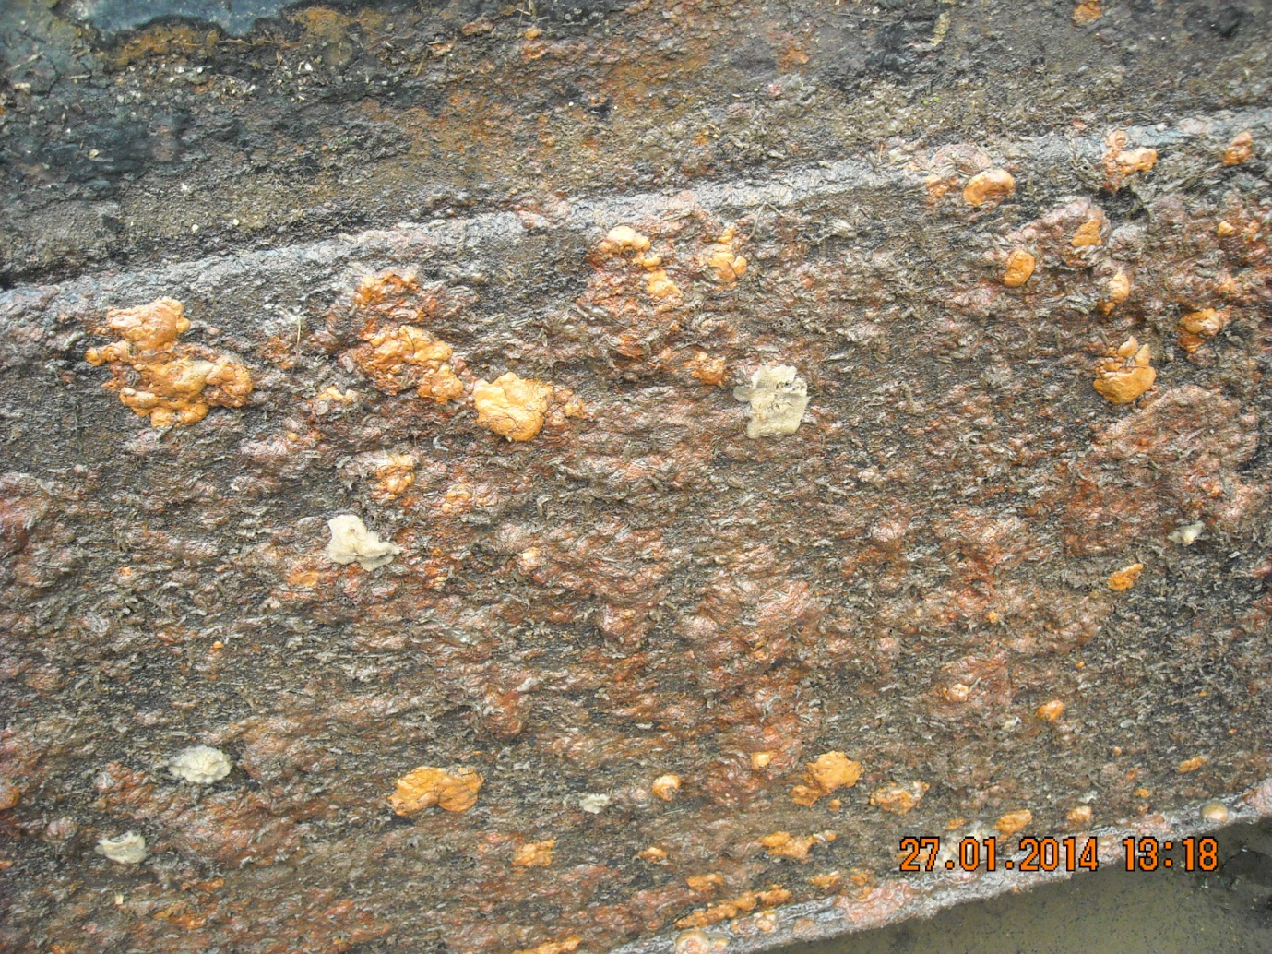
MICROBIALLY INDUCED CORROSION 3 SEVERE GALLIONELLA ATTACK ON A NARROWBOAT

Slide 84
MICROBIALLY INDUCED CORROSION 4
OFTEN CLOSELY ASSOCIATED WITH THE GALLIONELLA SPECIES IS A SULPHUR OXIDIZING BUG (SOB) CALLED THIOBASCILLUS FERRO-OXIDANS. THIS LEAVES A SIMILAR PIT TO THE GALLIONELLA SPECIES BUT WITH VERTICAL STEPPED SIDES AND THE FLAT BOTTOM COVERED WITH A HARD WHITE SUBSTANCE. THE LATTER IS TETRA HYDRATED FERROUS SULPHIDE AND IS NON TOXIC.

Slide 85
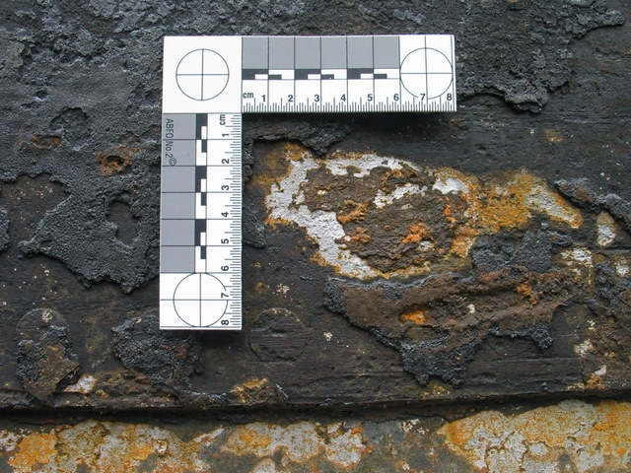
MICROBIALLY INDUCED CORROSION 5THIOBASCILLUSS ATACK ON A NARROWBOAT

Slide 86
MICROBIALLY INDUCED CORROSION 6
THERE ARE TWO FURTHER SULPHUR REDUCING BUGS (SRB) OF THE GENERA DESULPHOTOMACULUM AND DESULPHUROVIBRIO. THEY LEAVE THE SAME CHARACTERISTIC PITS BUT THE BOTTOM IS COVERED WITH THE HIGHLY CORROSIVE BLACK HYDROGEN SULPHIDE WHICH, IF SCRAPED, STINKS LIKE ROTTEN EGGS. THESE ARE NOT COMMONLY FOUND IN CANAL WATERS.

Slide 87
DEALING WITH MICROBES 1
IF A BOAT IS FOUND WITH EVIDENCE OF MICROBIAL ATTACK, IT IS NECESSARY TO DEAL WITH IT TO PREVENT, IF POSSIBLE, IT HAPPENING AGAIN. THE WHOLE AREA SHOULD BE WAS WITH COPIOUS AMOUNTS OF HIGH PRESSURE FRESH WATER. WHEN DRY THE AREA AFFECTED SHOULD BE COATED WITH STERGENE BLEACH (SODIUM HYPERCHLORIDE) AND LEFT FOR TWENTY FOUR HOURS. AFTERWARD ANOTHER HIGH PRESSURE FRESH WATER WASH IS NECESSARY FOLLOWED BY DRYING AND RECOATING. NEVERTHELESS, THE MICROBES CAN STILL LIVE UNDERNEATH NEARBY PAINT COATINGS.

Slide 88
DEALING WITH MICROBES 2
WARNING
SODIUM HYPERCHLORIDE IS HIGHLY CAUSTIC AND TOXIC. IT MUST BE TREATED WITH GREAT CARE AND RUBBER GLOVES, WELLINGTON BOOTS AND EYE SHIELDS ARE ESSENTIAL.

Slide 89
ANODES 1
TO REDUCE THE POSSIBILITY OF PITTING AND GENERAL CORROSION OF A VESSEL’S UNDERWATER SHELL PLATING IT IS GOOD PRACTICE TO FIT HER WITH SACRIFICIAL ANODES. WITH A VESSEL FITTED WITH A PROPELLER OF BRONZE IT IS THE COPPER IN THE BRONZE THAT PROVIDES THE DRIVING FORCE FOR THE GALVANIC PROCESS. WHEN NO COPPER OR BRONZE IS PRESENT THE DRIVING FORCES IS THE ELECTRIC POTENTIAL DIFFERENCE BETWEEN THE CEMENTITE AND PEARLITE AND FERRITE CRYSTALS IN THE STEEL’S MICROSTRUCTURE THAT PROVIDES THE DRIVING FORCE.

Slide 90
ANODES 2
IF AN IRON OR STEEL VESSEL FLOATS IN FRESH WATER THE ANODES SHOULD BE OF MAGNESIUM OR ALUMINIUM BUT IF SHE IS IN SALT WATER THEN THE ANODES SHOULD BE OF ZINC.

Slide 91
ANODES 3
FOR THE ANODES TO WORK PROPERLY THEY MUST BE PROPERLY ELECTRICALLY CONNECTED TO THE STEEL HULL AND THENCE TO THE PROPELLER VIA THE ENGINE AND SHAFT.
ANODES MUST NEVER BE PAINTED. TO PREVENT ACCIDENTAL PAINTING, COAT THEM WITH SOFT SOAP. THIS WASHES OFF WHEN THE VESSEL IS PUT AFLOAT TAKING ANY ACCIDENTAL PAINT SPLASHES WITH IT.

Slide 92
ANODES 4
TO CHECK THAT AN ANODE IS WORKING, IF THE VESSEL IS FITTED WITH A PROPELLER TOUCH THE BLACK LEAD OF A MULTIMETER TO THE ANODE AND THE RED LEAD TO THE PROPELLER WITH THE METER SET TO RESISTANCE (OHMS). IF THE ANODE IS WOKING CORRECTLY THE METER SHOULD READ ABOUT 0.5 OHMS. IF THERE IS NO PROPELLER TOUCH THE BLACK LEAD TO THE STEEL HULL WHEN THE METER SHOULD READ ABOUT 0.2 TO 0.3 OHMS. EACH ANODE SHOULD BE CHECKED AND THE RESULTS RECORDED IN THE MARINE SURVEYOR’S REPORT.
THE ANODES MUST BE PLACED SO THAT THEY CAN ‘SEE’ THE AREA THEY ARE PROTECTING – USUALLY ABOUT 4 TO 5 SQUARE METRES OF HULL AREA PER ANODE.

Slide 93
ANODES 5
ANODES SHOULD BE RENEWED WHEN ABOUT 80% WASTED. AT EVERY SLIPPING THEY SHOULD BE CLEANED BACK TO BRIGHT METAL.
THE WEIGHT OF ANODIC MATERIAL IS A DIRECT FUNCTION OF THE BOAT’S WETTED SURFACE AREA.

Slide 94
ANODES 6
THE WETTED SURFACE AREA OF THE HULL MAY BE CALCULATED FROM: -
S_{A} = k.L_{WL}(B_{WL} + 2d) m²
L_{WL} = Waterline Length m
B_{WL} = Waterline Breadth m
d Mean draught m
k = Constant
N.B. THE FORMULA FOR WETTED SURFACE AREA GIVEN IN M. G. DUFF’S LITERATURE IS INCORRECT.

Slide 95
ANODES 7
THE REQUIRED CURRENT AMPERAGE IS CALCULATED FROM
A = S_{A} x C_{D}/1000 Amps
S_{A} = Wetted Surface Area m²
C_{D} = Current Density
10 – 30 generally about 20 mA/m²

Slide 96
ANODES 8
THUS THE TOTAL WEIGHT OF ANODIC MATERIAL REQUIRED TO GIVE THAT AMPERAGE IS CALCULATED FROM: -
W_{A} = A x Y x 8760 kg
C
W_{A} = Weight of required anodic material kg
Y = Required life in years Y
8760 = Number of hours in one standard year h
C = Capacity of Anodic Material ah/kg
= 780 for zinc
= 2700 for aluminium
= 2000 for magnesium
N.B. THE RECOMMENDED LIFE OF ANODES FOR SMALL CRAFT IS TWO YEARS (THREE YEARS MAXIMUM). THIS REQUIRES THE VESSEL TO BE SLIPPED OR DRY DOCKED EVERY TWO YEARS AND THE MARINE SURVEYOR’S REPORT SHOULD CARRY A SUGGESTION TO THAT EFFECT.

Slide 97
FINISH
THAT, FOLK, IS THE END OF THIS LECTURE. I HOPE THAT YOU HAVE LEARNED SOMETHING AND HAVE FOUND, AND WILL FIND, IT USEFUL. IF YOU CARE TO GIVE ME YOUR EMAIL ADDRESSES I WILL ARRANGE TO HAVE A COPY OF THE SLIDES SENT TO YOU.

